Slide 1


Public Library System Management
Using customized DBMS

Slide 2





1
Team 7
Seattle Public Library – DBMS Course Project
Usama Ather
Mayank Jha
Prerak Patel
Sandeep Mukhopadhyay
Kshama Sharma

Slide 3
1
Project Map
Seattle Public Library – DBMS Course Project
AGENDA
1
Business Problem – defining business objectives for the project
2
Conceptual Design – developing ER diagram for the problem
3
Logical Design – developing relational schema from ERD
4
Normalization – ensuring logical design is in 4NF before SQL modeling
5
Implementing Database – creating database in SQL
6
Querying Database – developing queries to meet our business objectives

Slide 4









1
Business Problem
Our project aims to model crucial attributes of a very complex DBMS deployed by most libraries
Entities & Relationships
Library User –
individual having a personal account in the DBMS
Genre –
books are further categorized into genres
Publisher –
each book is released by a publisher
Books –
core purpose of Library Users to come to the library
Author –
each book is written by one or more authors
Fines –
Library User is fined for every over-due book
Objectives
Multiple sorting parameters to improve book search
Resource optimization by charging fines
Improving customer satisfaction by deploying a queue system where users can reserve a book

Slide 5
Designing DBMS

Slide 6
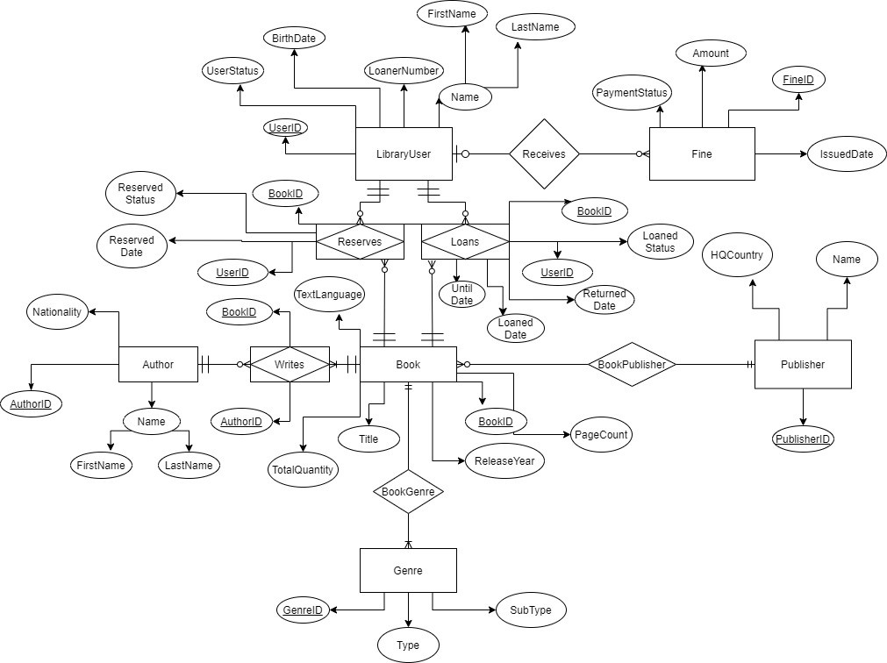



1
Conceptual Design
Entity Relationship Diagram
Developing entity relationship diagram for the problem
Relationship between Library User > Book & Author > Book is a many-to-many relationship, that’s why we created three associative identity tables:
Reserves –
join queue for a book which isn’t available right away
Loans –
user borrows a book for a pre-specified time period
Writes –
each book is written by one or more authors

Slide 7
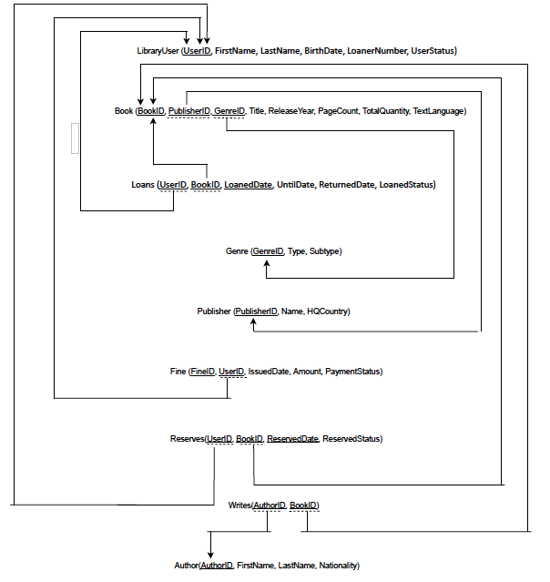
1
Logical Design
Relational Schema
Developing relational schema from ER diagram
Relational schema will allow us to set the framework for implementation of our DBMS

Slide 8
1
Normalization
All our entities are in 4NF and ready to be implemented in SQL
Everything needs to be in 4NF before implementation
S.No. | Entity | 1NF | 2NF | 3NF | 4NF
 | LibraryUser | Satisfied as each column is atomic. | Satisfied as Primary Key: UserID, consists of a single attribute. | Satisfied as no functional transitive dependency can be seen. All of the columns are dependent on only and only the Primary Key. | Satisfied as no multi-valued dependency can be seen.
2. | Book | Satisfied as each column is atomic. If the same book is in different languages, it is counted as separate books. | Satisfied as Primary Key: BookID, consists of a single attribute. | Satisfied as no functional transitive dependency can be seen. All of the columns are dependent on only and only the Primary Key. | Satisfied as no multi-valued dependency can be seen.
3. | Genre | Satisfied as each column is single-valued. | Satisfied as Primary Key: GenreID, consists of a single attribute. | Satisfied as no functional transitive dependency can be seen. All of the columns are dependent on only and only the Primary Key. | Satisfied as no multi-valued dependency can be seen.
4. | Publisher | Satisfied as each column is single-valued. | Satisfied as Primary Key: PublisherID, consists of a single attribute. | Satisfied as no functional transitive dependency can be seen. | Satisfied as no multi-valued dependency can be seen.
5. | Author | Satisfied as each column is single-valued. | Satisfied as Primary Key: AuthorID, consists of a single attribute. | Satisfied as no functional transitive dependency can be seen. | Satisfied as no multi-valued dependency can be seen.
6. | Fine | Satisfied as each column is single-valued. | Satisfied as Primary Key: FineID, consists of a single attribute. | Satisfied as no functional transitive dependency can be seen. | Satisfied as no multi-valued dependency can be seen.
7. | Loans | Satisfied as each column is single-valued. | Satisfied as Primary Key: LoanedDate, consists of a single attribute. | Satisfied as no functional transitive dependency can be seen. | Satisfied as no multi-valued dependency can be seen.
8. | Reserves | Satisfied as each column is single-valued. | Satisfied as Primary Key: ReservedDate, consists of a single attribute. | Satisfied as no functional transitive dependency can be seen. | Satisfied as no multi-valued dependency can be seen.
9. | Writes | Satisfied as each column is single-valued. | Satisfied as table is made up of two Primary Keys: AuthorID and UserID. | Satisfied as no functional transitive dependency can be seen. | Satisfied as no multi-valued dependency can be seen.

Slide 9
Implementing DBMS in SQL

Slide 10
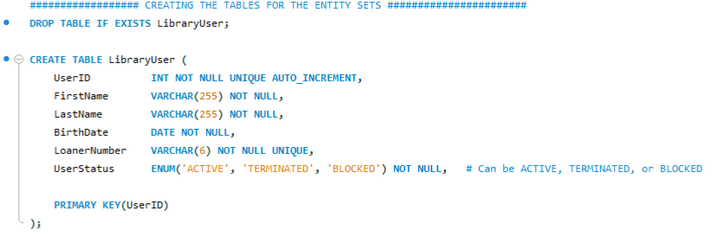
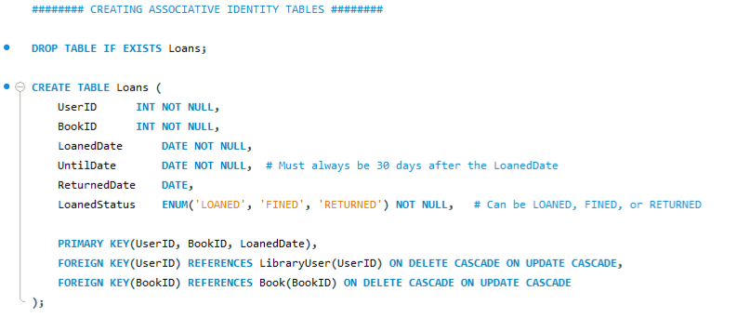
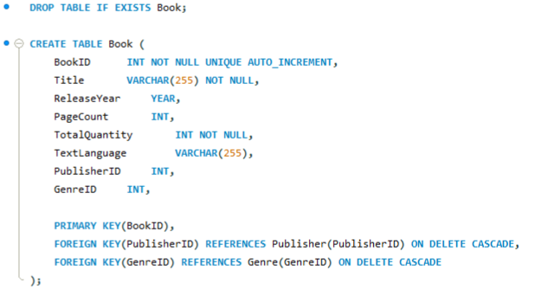
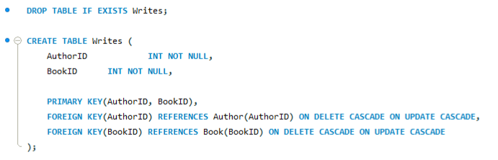
1
Implementation
Creating database in SQL
Using CREATE to generate entity tables
Using CREATE to generate associative entity tables

Slide 11
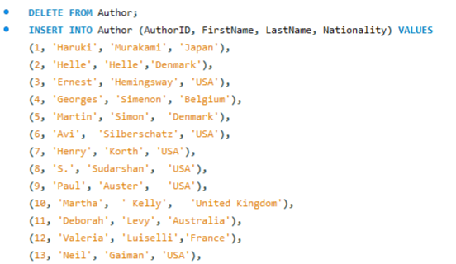
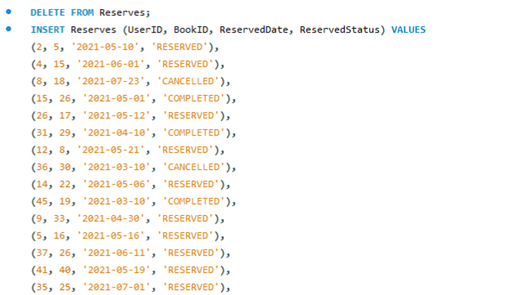
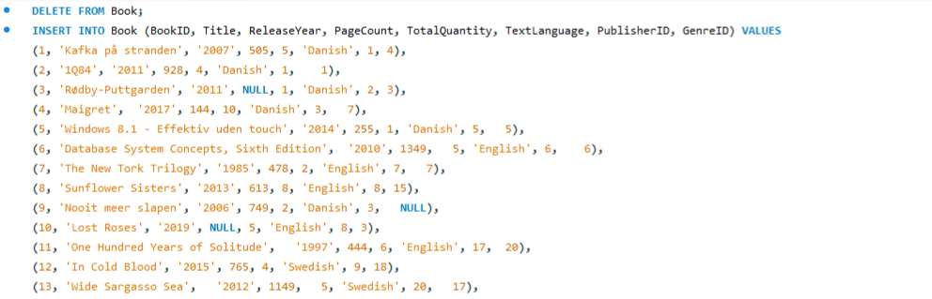
1
Implementation
Populating database in SQL
Using INSERT to populate tables

Slide 12
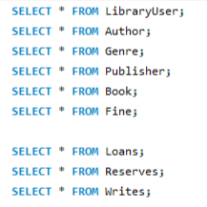
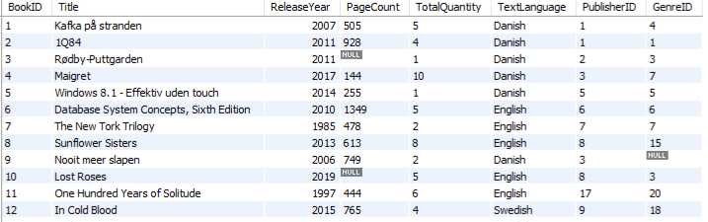
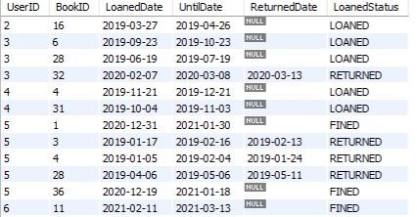
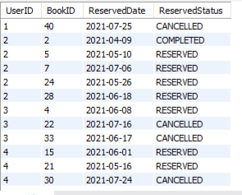
1
Implementation
Relational instance in database
Using SELECT to view corresponding tables

Slide 13
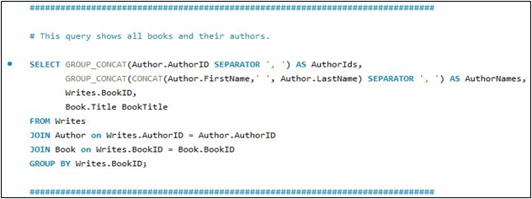
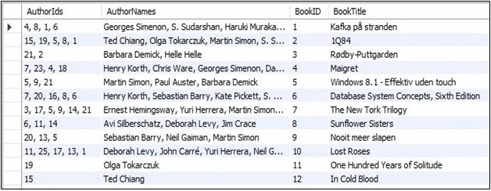

1
Querying the DBMS
Query Objective: show all the books in the library and the full name of their respective authors
Business inferences from our database
Query
Output
Users, who liked a particular book, tend to read more books from its co-authors. Output, as above, help library predict which author’s books is likely to be in demand among its users who have loaned a particular book.

Slide 14
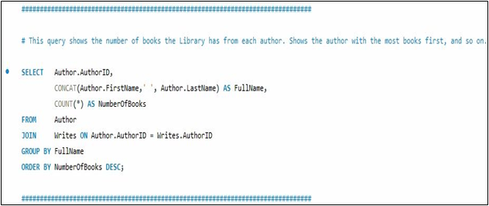
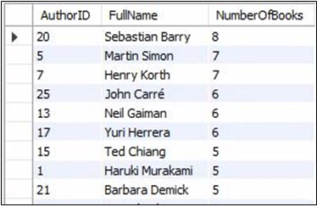
1
Querying the DBMS
Query Objective: show the number of unique books (titles) the library has from each author in descending order
Business inferences from our database
Query
Output
This query refers strictly to the number of different book titles present from each author. When compared with loan & reservation frequency, it can help library to select which new titles to buy, depending on the popularity amongst its users.

Slide 15
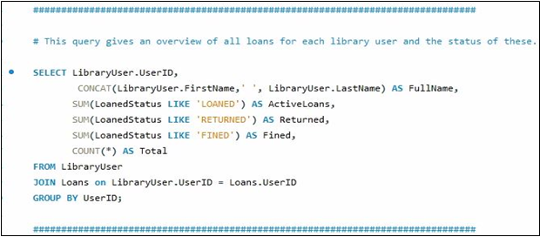
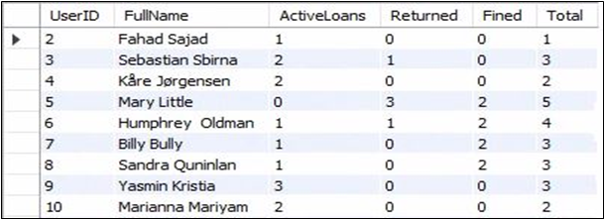
1
Querying the DBMS
Query Objective: generate an overview of all loans (separated into categories by their status) for each user
Business inferences from our database
Query
Output
This query helps library identify most frequently visiting users. Depending upon their fine records, library system can incentivize or penalize their new loans.

Slide 16
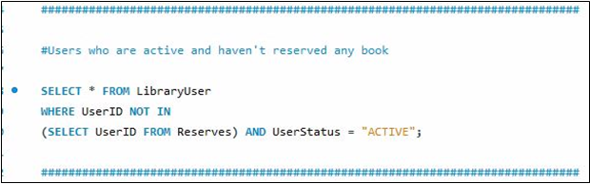
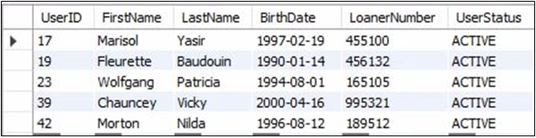
1
Querying the DBMS
Query Objective: give details of library users with active user-status and no reservations
Business inferences from our database
Query
Output
This will help library manager identify active users who aren’t availing the reservation facility. Library manager can make them aware of such facilities to boost their user satisfaction.

Slide 17
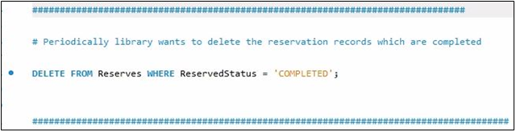
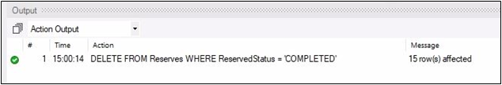
1
Querying the DBMS
Query Objective: modification query to help system manager delete completed reservations periodically
Business inferences from our database
Query
Output
‘Completed’ reservation data, with time, turns redundant. It also increases unnecessary load on the database. So, to avoid that, library manager can periodically delete all reservations which are completed.

Slide 18
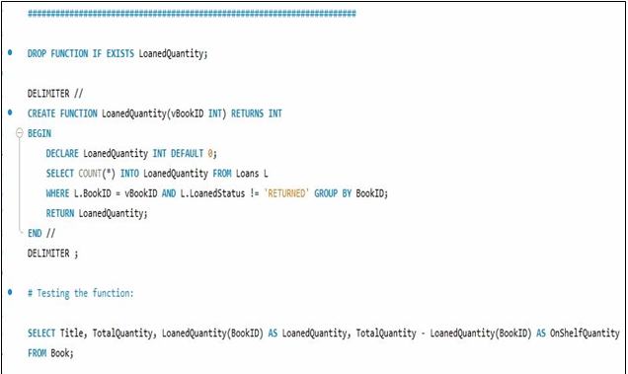
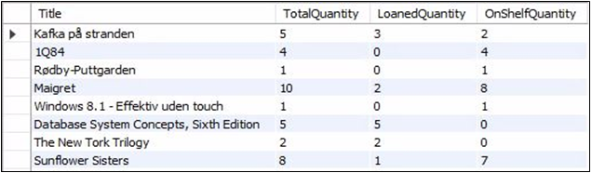
1
Querying the DBMS
Query Objective: SQL Function to return how many copies of a given book are loaned
Business inferences from our database
SQL Function
Output
Such function help managers to check loaned quantity and on-shelf quantity of a particular book of interest. This helps them, not just in keeping track of shelf-space, but also in informing availability of a particular book to the users.

Slide 19
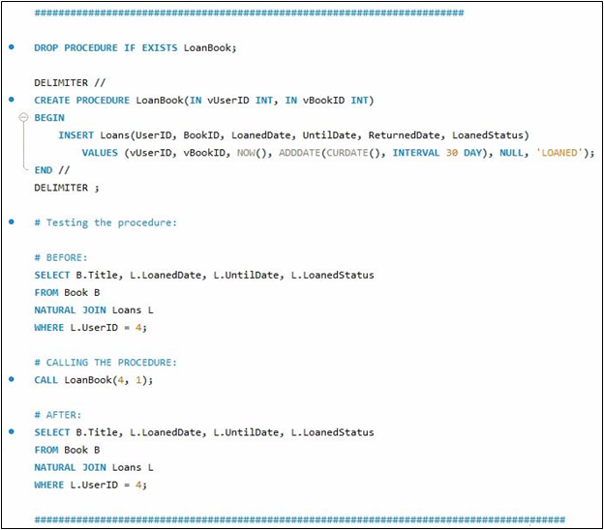
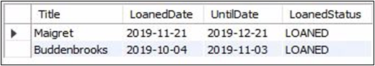
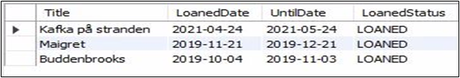
1
Querying the DBMS
Query Objective: SQL Procedure defined to create a new loan for the given User ID & Book ID
Business inferences from our database
SQL Procedure
Output
This procedure helps in updating the loans table with new entries. The librarian just needs to enter Book ID and User ID. It not only improves efficiency of loaning process, but also improves the ease of doing business.

Slide 20
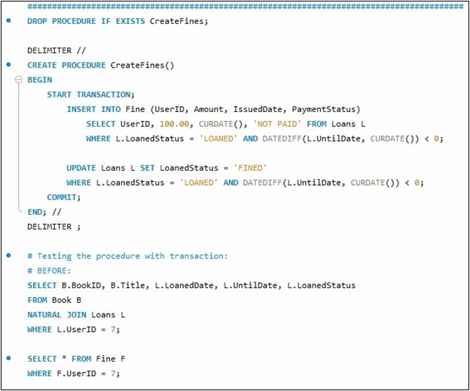
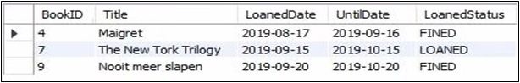
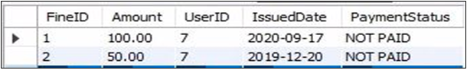
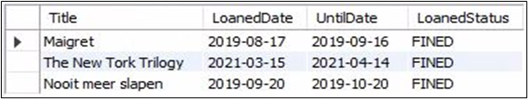
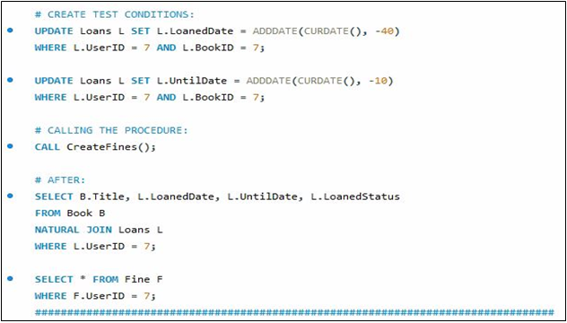
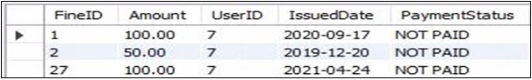
1
Query Objective: SQL Procedure defined to create fines for every overdue loan that has a status of 'LOANED'. It also set the loan status as ‘FINED’
Querying the DBMS
Business inferences from our database
SQL Procedure
Output
A robust fine system is essential for efficient functioning of the library. It helps, not just in sound inventory management, but also in avoiding dissatisfaction of sincere customers.

Slide 21
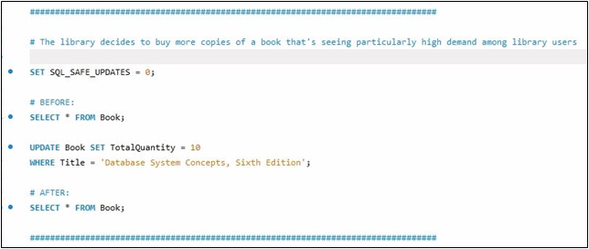
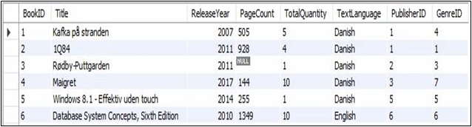
1
Querying the DBMS
Query Objective: update the number of copies of a particular book when new copies are procured
Business inferences from our database
Query
Output
If the library is seeing a sustained rise in popularity of a particular book, it might procure more copies of it. This query will help manager to update new quantities procured within the database, so to maintain correct records on loaned and on-shelf quantities.

Slide 22
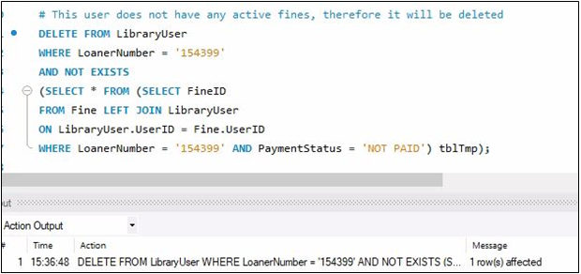
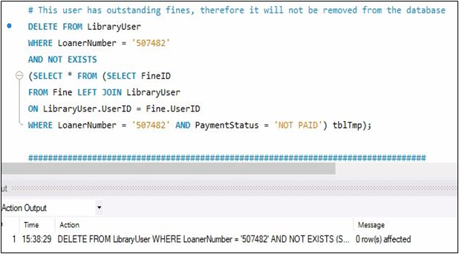
1
Querying the DBMS
Query Objective: delete query to delete the details of a user whenever he/she opts for so (provided there are no unpaid fines)
Business inferences from our database
Query
Data-privacy is paramount for any institution holding public database. In such case, this query will help the manager to delete every detail of a particular user, who opts for so, provided they have cleared all their fines.

Slide 23
Thank You!

